Slide 1
OGTIP
Oeson - Data Science Internship
Final Project Report
OESON
Unmilan Baruah

Slide 2
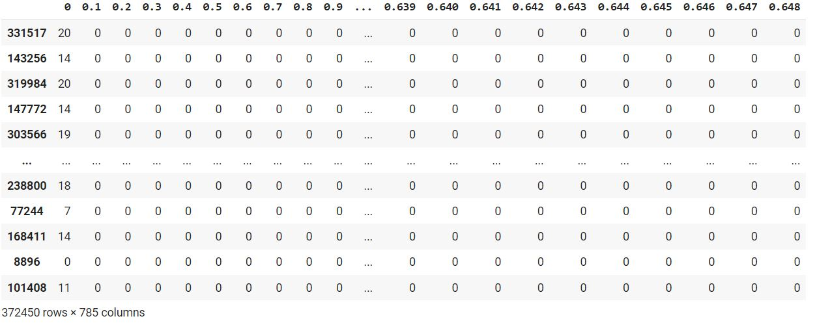
Description
Given the handwriting data set of a popular language alphabets that contains various handwriting script for each individual alphabet of that language taken from different individuals in real time.
Objectives:
Prepare a detailed Analysis of the dataset.
Perform EDA tasks.
Decide the best algorithm for implementation.
Optimize the learning parameters for model performance.

Slide 3
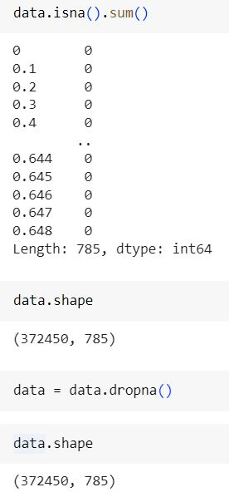
Exploratory Data Analysis (missing values)
The first step in EDA is to usually check for any missing values in the dataset.
In this dataset, we have 372450 rows and 785 columns.
However, no missing values can be observed in the dataset.
Also, there are only numerical values in the dataset making it almost clean.

Slide 4
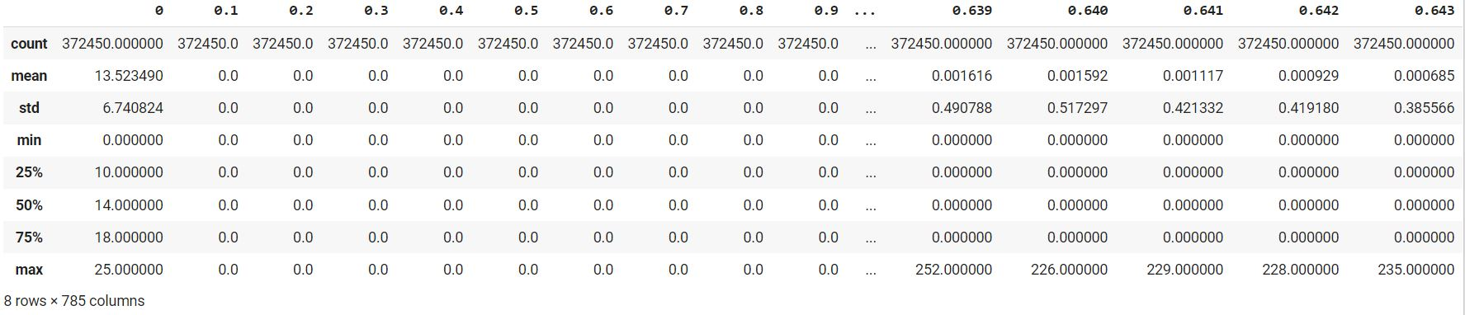
Exploratory Data Analysis (features selection)
The column 'o' of the dataset has values ranging from 0 to 25. While rest columns does not have any range or descriptive stats other than their counts.
This means that column '0' is the target column for the dataset.
Moreover, after removing the target column we will have 784 attributes. In other words, we will have 28*28 pixels images.

Slide 5
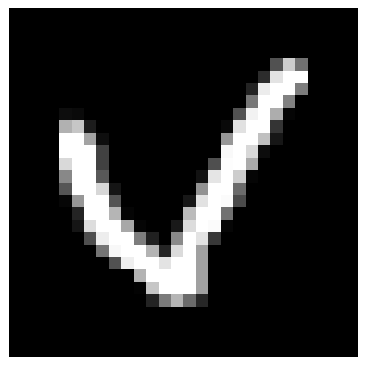
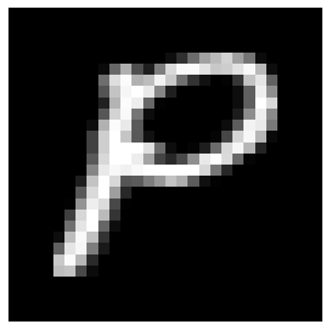
Exploratory Data Analysis (Visualization)

Slide 6

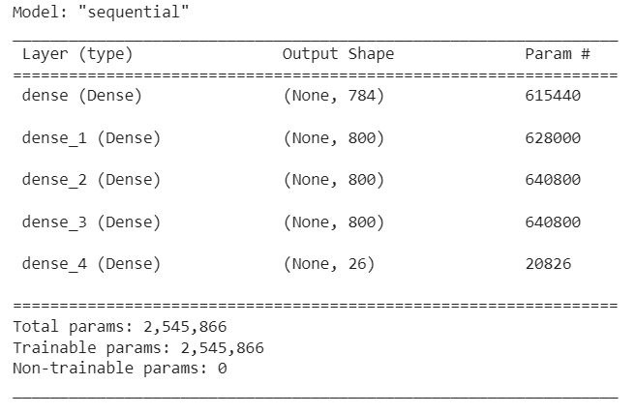
Splitting the data and preparing the model
The Target variable 26 unique values ranging from 0 to 25.
Now, we split the whole dataset for training and testing.
We are using approx. 78 percent for training and 22 percent for testing.
Model strategy:
Input layer: 784 units (image_size: 28*28), activation: ‘relu’
Hidden layer: 800 units, activation: ‘relu’
Hidden layer: 800 units, activation: ‘relu’
Hidden layer: 800 units, activation: ‘relu’
Output layer: 26 units, activation: ‘relu’
Optimizer: ‘adam’
Loss function: ‘sparse categorical crossentropy’.
Metrics: ‘accuracy’
Batch size: 100

Slide 7
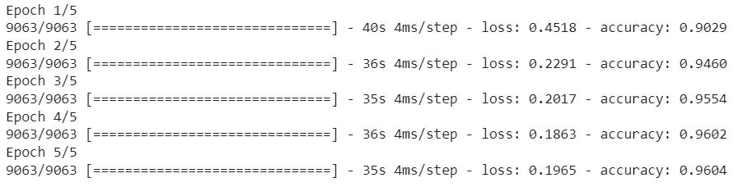
Performance analysis (training)
With appropriate optimizer and loss functions, we are able to achieve an accuracy of about 96 percent for ANN.

Slide 8
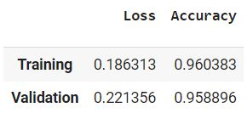
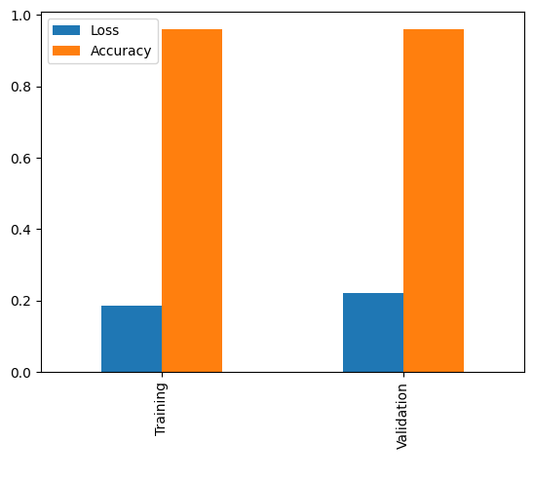
Performance analysis (validation and overall evaluation)
Not much difference between training and validation accuracy.
This means the model is unbiased.

Slide 9
Conclusion
The model is able to recognize handwritten alphabets with above 95 percent accuracy.
This clearly suggests that, even though the model mis-classifies some of the handwritten alphabets, most of the letters are correctly recognized.
The model is not biased, due to the negligible difference between training and testing accuracy. Thus, the project is able to achieve its objective.

Slide 10
Thank you

